Slide 1


Slide 2
LET'S RECAP
COURSE 2 WAS ABOUT:
Notes on markup languages & styling
HTML - introduction
CSS - introduction
Version Control Systems
GIT

Slide 3
WEB DEVELOPMENT WITH PHP
COURSE #03
Notes:
ok, let's go

Slide 4
TOPICS
COURSE #03
PHP syntax basics
Variables and constants
Operators
PHP conditional statements and operators
Homework
Notes:
topics we'll cover this week

Slide 5
1. PHP SYNTAX BASICS
Notes:
a quick introduction in programming and how it evolved

Slide 6
FIRST, WHAT IS A LANGUAGE?
SYMBOLS
All the valid characters that can be used in that language: Letters, digits, other symbols . , ; ? () {} !
VOCABULARY
All the valid words or terms made up with the symbols and that have a meaning
In programming languages these are all the reserved terms, function names etc.
Notes:
desktop - enterprises, B2B. Stability, hard regulators
web - more freedom. Flexibility. Resource sharing

Slide 7
FIRST, WHAT IS A LANGUAGE?
SYNTAX
All the rules which we can use to form valid sentences in the language
In programming, these rules define valid instructions
SEMANTICS
The field of study concerned with the meaning of the sentences
In programming: how the instructions work, what do they do
Notes:
desktop - enterprises, B2B. Stability, hard regulators
web - more freedom. Flexibility. Resource sharing

Slide 8

IT DICTIONARY
SYNTAX
In computer science, the syntax of a computer language is the set of rules that defines the combinations of symbols that are considered to be a correctly structured document or fragment in that language.
Simply put: the syntax defines the sequence in which terms and symbols are put together to form correct instructions.

Slide 9
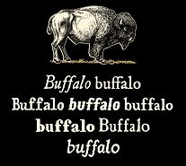


SPEAKING OF SYNTAX AND SEMANTICS
This is a grammatically correct sentence in English! ^{[1]}
[1] https://en.wikipedia.org/wiki/Buffalo_buffalo_Buffalo_buffalo_buffalo_buffalo_Buffalo_buffalo

Slide 10
PHP SYNTAX
FILES The PHP code must be put inside files with the .php extension
project/
index.php
includes/
config.php
library.php
database.php

Slide 11
PHP SYNTAX
OPEN AND CLOSING TAGS The PHP code must be put between the PHP open and closing tags.
<html> <head> <title>PHP Test</title> </head> <body> <?php echo '<p>Hello World</p>'; ?> </body> </html>

Slide 12
PHP SYNTAX
INSTRUCTIONS Each instruction should end with a semicolon. You can have multiple instructions on a single line, but the best practice is to put one instruction per line.
<?php
echo '<p>Hello World</p>' ;
echo '<p>Welcome to our site!</p>' ;
?>

Slide 13
PHP SYNTAX
COMMENTS It is recommended to comment each section of your code which is not straight-forward.
<?php // You can comment an entire line
echo 'Hello'; // or just a part of it ?>
<?php /*
You can comment multiple lines
in the same time.
Like this one.
*/
?>

Slide 14
2. VARIABLES AND CONSTANTS
Notes:
a quick introduction in programming and how it evolved

Slide 15

PHP VARIABLES
WHAT ARE VARIABLES?
A variable is just a storage area.
You put things into your storage areas (variables) so that you can use and manipulate them later in your code.
Things you'll usually want to store are numbers and text.

Slide 16

PHP VARIABLES
EXAMPLE
<?php fasttrackit_course = "PHP"; fasttrackit_sessions = 12; ?>
Anything missing?
<?php
// this is how we define variables $fasttrackit_course = "PHP"; $fasttrackit_sessions = 12; ?>

Slide 17


TIPS & TRICKS
KEEP YOUR FILES STRUCTURED
php_course/
your_name/
week_2/
potato.html
style.css
homework.html
week_3/
example_if.php
example_variables.php
homework_1.php
homework_2.php

Slide 18
PHP VARIABLES
LET'S TRY IT OUT
1. Output "Hello world!" to screen using a variable:
<?php $text = "Hello world!"; echo $text; ?>

Slide 19
PHP VARIABLES
LET'S TRY IT OUT
2. Output the number of students enrolled in the FastTrackIT course. The result should be a page with this text: "There are 10 students in the PHP course". Start with a file containing the following code:
<?php $students = 10;
?>

Slide 20
PHP CONSTANTS
A constant is just like a variable but it cannot have its value changed during program execution.
<?php
// this is how we define constants
define('COURSE', "Web development with PHP"); define('STUDENTS_COUNT', 10);
// .. and this is how we use them
echo COURSE;
?>
So, when to use constants and when variables?

Slide 21
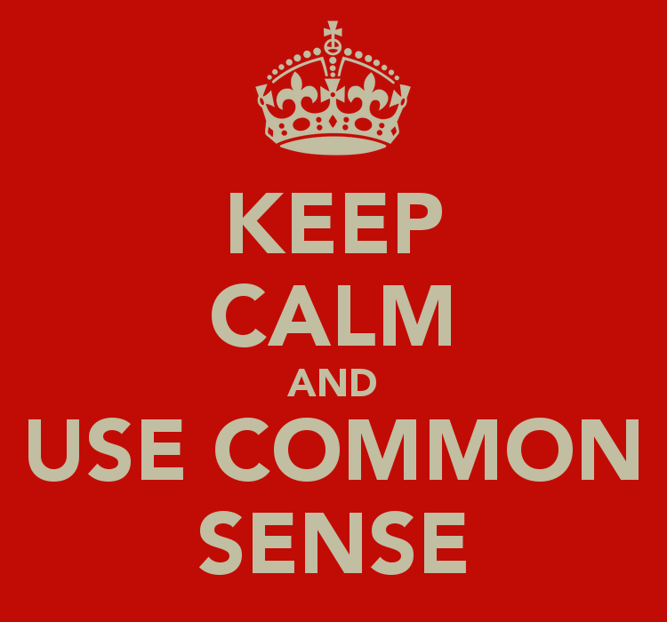
TIPS & TRICKS
USE MEANINGFUL NAMES
<?php
// not very good naming $total = 10;
define('NAME', "Web development with PHP");
// better naming $students_count = 10;
define('COURSE_NAME', "Web development with PHP");
?>

Slide 22
3. OPERATORS
Notes:
a quick introduction in programming and how it evolved

Slide 23
ASSIGNMENT OPERATORS
Using assignment operator ("="), you can set (or change) the value of a variable. If the variable doesn't exist, it is created on the spot.
<?php
print($course); // we get an error, we try to print a variable that doesn't exist
$course = "Web development";
print($course); // $course contains "Web development"
$course = "Web development with PHP"; print($course); // $course is now "Web development with PHP"
?>

Slide 24
CONCATENATION
Concatenation (".") is the text manipulation method when you join two or more texts together.
<?php $maker = "Ford"; $model = "Escort"; $car = $maker . $model; // $car contains "FordEscort" $car = $maker . " " . $model; // $car contains "Ford Escort" print("I drive a " . $car); // "I drive a Ford Escort" print("I drive a " . $maker . " " . $model); // "I drive a Ford Escort" ?>

Slide 25
CONCATENATION
LET'S TRY SOMETHING ELSE
<?php $count = 10; print('There are $count students in the room today'); print("There are $count students in the room today"); print('There are ' . $count . ' students in the room today'); ?>
TWO THINGS TO REMEMBER 1. Variables inside double quotes are replaced by their value. 2. PHP converts number to text when you try to concatenate them.

Slide 26
MATHEMATICAL OPERATORS
ADDITION
<?php $a = 1; $b = 2; $c = 3; $d = 4; $sum = $a + $b; // $sum is 3
$sum = $sum + $c; // $sum is 6
$sum += $d; // $sum is 10 (identical with $sum = $sum + $d)
?>

Slide 27
MATHEMATICAL OPERATORS
LET'S DO AN EXERCISE
<?php $students_in_the_room = 13; $students_not_present = 2; $students_in_other_courses = 30;
$students_php_text = "Students in the PHP course: "; $students_total_text = "Total FastTrackIT students: "; ?>
1. Compute and print the number of $students_in_php_course with the message "Students in the PHP course: " before the value.
2. Similarly, compute and print the number of $students_in_all_courses

Slide 28
MATHEMATICAL OPERATORS
SUBTRACTION, MULTIPLICATION, DIVISION
Similarly with addition, you can make all kind of mathematical operations.
<?php
$students_in_the_room = $students_in_php_course - $students_not_present; $hands_in_the_room = $students_in_the_room * 2; // How do you count the number of sheep in a herd? $number_of_sheep = $number_of_sheep_feet / 4;
?>

Slide 29
MATHEMATICAL OPERATORS
LET'S PLAY AROUND WITH BASIC OPERATIONS
2 + 3
2 + 3 - 1
2 + 1 * 4
(2 + 1) * 4
3 - 2 / 2
(6 - 2) / 2
2 + 2 + 2 + 2
(1 - 2) * 3
7 / 4
Determine and print the results in the form:
The result for "[formula]" is [result] and it is correct!

Slide 30
MATHEMATICAL OPERATORS
FLOATING POINTS
<?php $a = 1.75; $b = 1.25;
?>
We can apply all previous operations on these as well! Let’s try it!
<?php print ($a + $b); print ($a - $b); ?>
<?php print ($a * $b); print ($a / $b); ?>
Notice that we do not have to tell PHP that we are using floating numbers, he already knows it!

Slide 31
4. PHP CONDITIONAL STATEMENTS AND OPERATORS
Notes:
a quick introduction in programming and how it evolved

Slide 32
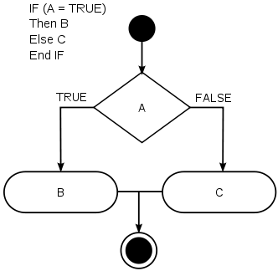
IT DICTIONARY
CONDITIONAL STATEMENTS
Features of programming languages which perform different computations or actions depending on whether a programmer-specified condition evaluates to true or false.

Slide 33
IT DICTIONARY
BOOLEAN VARIABLES
A boolean is a variable with 2 possible values:
TRUE
FALSE
" The best thing about a boolean is even if you are wrong, you are only off by a bit. "

Slide 34
BOOLEAN EXPRESSIONS
To write the conditions for conditional statements, we need more than boolean variables, we need boolean expressions. A boolean expression is a sequence of code which PHP can evaluate to TRUE or FALSE.
LET'S SEE AN EXAMPLE
<?php $username = "admin"; $is_admin = ($username == "admin"); // $is_admin is set to TRUE $is_member = ($username == "member"); // $is_member is set to FALSE ?>
Notes:
In practice, you need more that booleans
We need to write code which checks whether some conditions are met
Then do some action if they're met and another action if not
The code which checks the conditions doesn't do any action itself
It's just an expression which can be evaluated to TRUE or FALSE => boolean expression
For example, in a login when a user enters a username and a password
This is a simpler example:

Slide 35
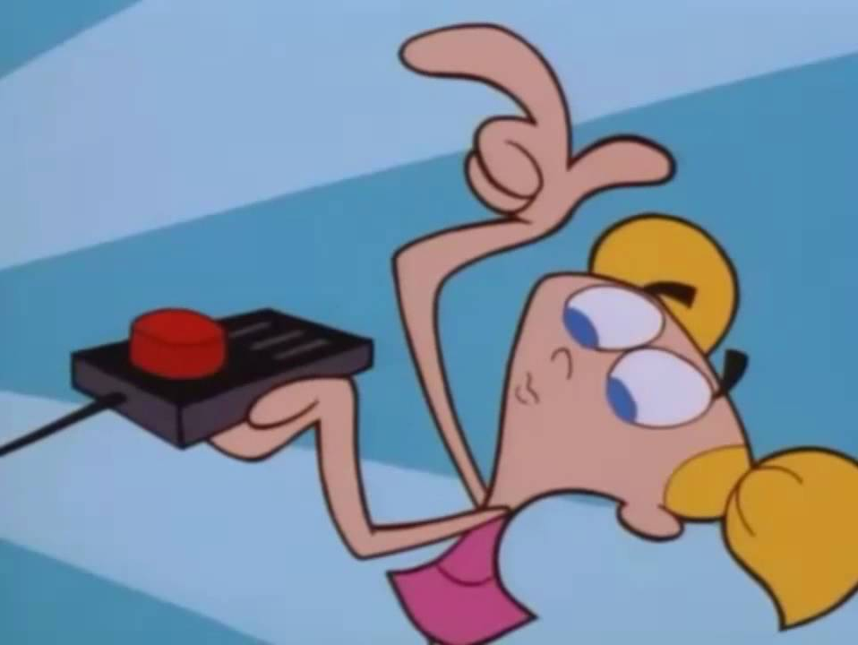
IF STATEMENTS
SYNTAX OF IF STATEMENTS
if (condition) { // action when condition is TRUE }
else { // action when condition is FALSE }
Notes:
In PHP conditional logic is implemented with the IF STATEMENT

Slide 36
IF STATEMENTS
EXAMPLE
TRY IT YOURSELF
<?php // in its simplest form, we can omit the "else" if ($username == "admin") { echo "You are allowed to see this."; }
// example with "if" and "else"
if ($username == "admin") { echo "You are allowed to see this."; } else { echo "You are not allowed to see this."; } ?>
<?php $points_theory = 7; $points_practice = 3; ?>
IF (the sum is 10)
display "Perfect grade!"
OTHERWISE
display "Not perfect :)"

Slide 37
BOOLEAN OPERATORS
COMPARISON OPERATORS
==
!=
===
!==
equal
not equal
identical
(same type)
not identical
(same type)
<
>
<=
>=
less than
greater than
less than
or equal
greater than
or equal
Notes:
There are two groups of boolean operators: comparison and logical
Comparison operators are used to compare two values
You can compare variables, constants or just plain v

Slide 38
BOOLEAN OPERATORS
EXAMPLES WITH COMPARISON OPERATORS
<?php $number = 3; $text = "3"; if ($number == $text) { print "Same"; } else { print "Not the same"; } // Try the same example with "===" ?>
<?php $first_number = 6.5; $second_number = 7; // if (first number is smaller) { // display 'First number is smaller' // } ?>

Slide 39
BOOLEAN OPERATORS
LOGICAL OPERATORS
We use logical operators to combine boolean variables and boolean expressions, so we can check more conditions in the same time.
&&
||
!
AND
(both true)
OR
(any is true)
not
(negation)

Slide 40
BOOLEAN OPERATORS
EXAMPLES WITH LOGICAL OPERATORS
<?php $salt = TRUE; $pepper = TRUE; // if (salt and pepper) { // display 'Yummy!' // } ?>
<?php $day = "saturday"; $hour = 10; // if ((day is saturday) and (hour is greater than 10)) { // display 'PHP course has started' // } ?>

Slide 41
MORE THAN TWO OPTIONS
WHAT IF … NOT … NOT?
MORE OPTIONS ???
<?php $username = "admin"; if ($username == "admin") { echo "You are allowed to see this."; } elseif ($username == "member"){ echo "You are allowed to see that."; } else { echo "You are not allowed to see anything."; } ?>
<?php if (condition1) { // option 1 } elseif (condition2){ // option 2 } elseif (condition3){ // option 3 } else { // option 4 } ?>

Slide 42
SWITCH STATEMENTS
THERE MUST BE A BETTER WAY :)
<?php $shoes_color = 'blue'; switch ($shoes_color) { case 'blue': { $shirt_color = 'green'; break; } case 'black': { $shirt_color = 'white'; break; } default: { $shirt_color = 'gray'; // goes with everything :) } } ?>

Slide 43
5. HOMEWORK :)

Slide 44
HOMEWORK
1. Given the following variables:
<?php $age_maria = 20; $age_ana = 25; $age_vlad = 17; $age_ionescu = 25; $age_george = 30; ?>
Compare the following ages and print the name of the oldest person:
Maria vs Ana
Alex vs Ionescu
Ionescu vs Ana
George vs Vlad

Slide 45
HOMEWORK
2. Given the following variables:
<?php $a = true; $b = false; $c = 1; $d = 0; ?>
Print the results for the following expressions:
not($a) and $b
$a or $b
not($a or $b)
$a === $c
$a and $c or $d
not($c) == $b
$a == $c
not($b) === $c
$a or not($b)

Slide 46
HOMEWORK
3. Given the following variables:
<?php $x = 5; $y = 6; ?>
Solve and explain the results for:
!(x > 6)
(x==6 && x==5)
(x==6 || x==5)
(x>-1 && y<10)

Slide 47
HOMEWORK
4. Given the following variables, defined in EXACTLY the order below:
<?php $a = 3; $c = 21; $e = 1; ?>
Write a script that, by comparing the 3 variables one to each other will print them in ASCENDING order.
Hint: Use conditional statements (IF or SWITCH) and comparison operators.

